Slide 1
Course4Week4
File created on: 8/17/2021 9:26:03 PM

Slide 2
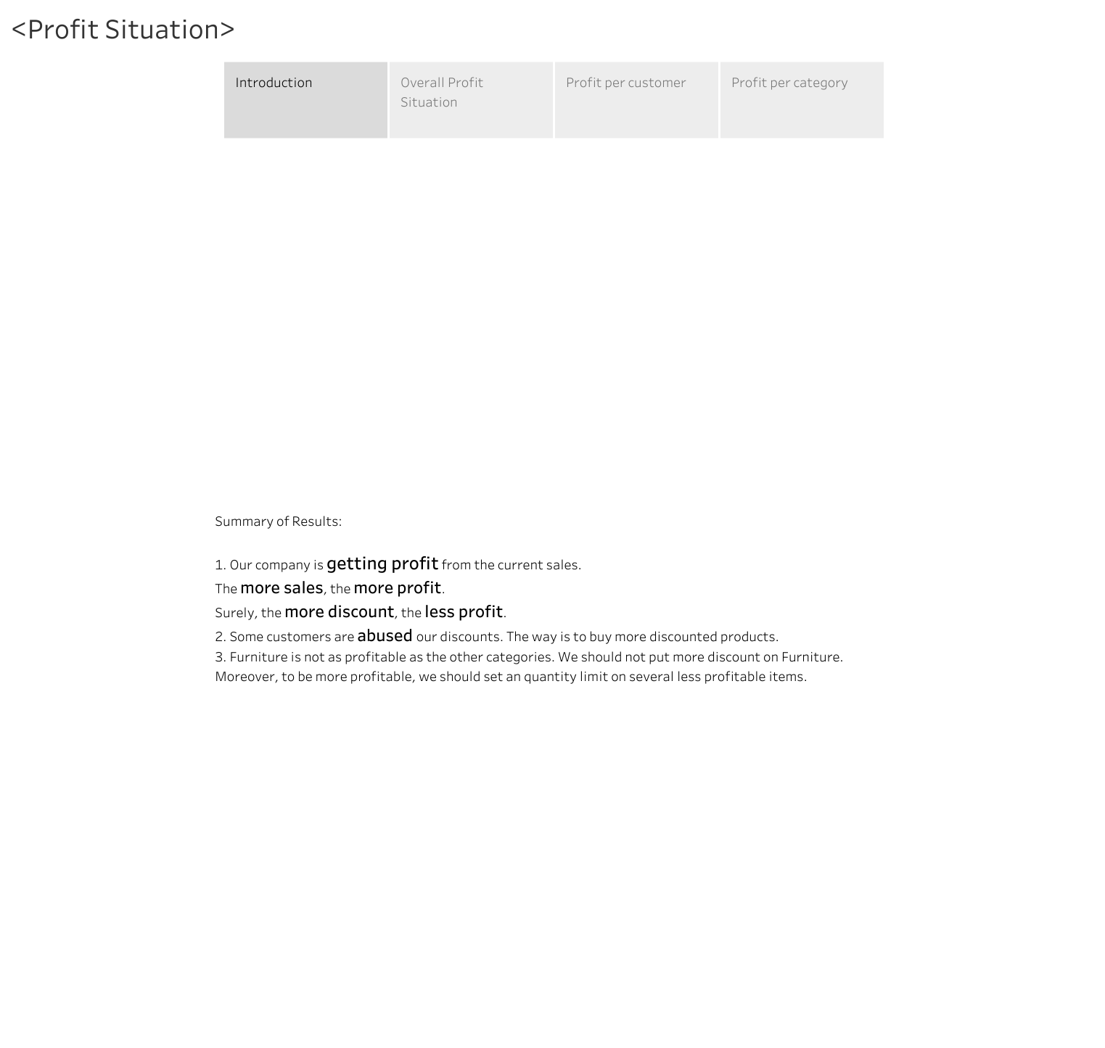

Slide 3
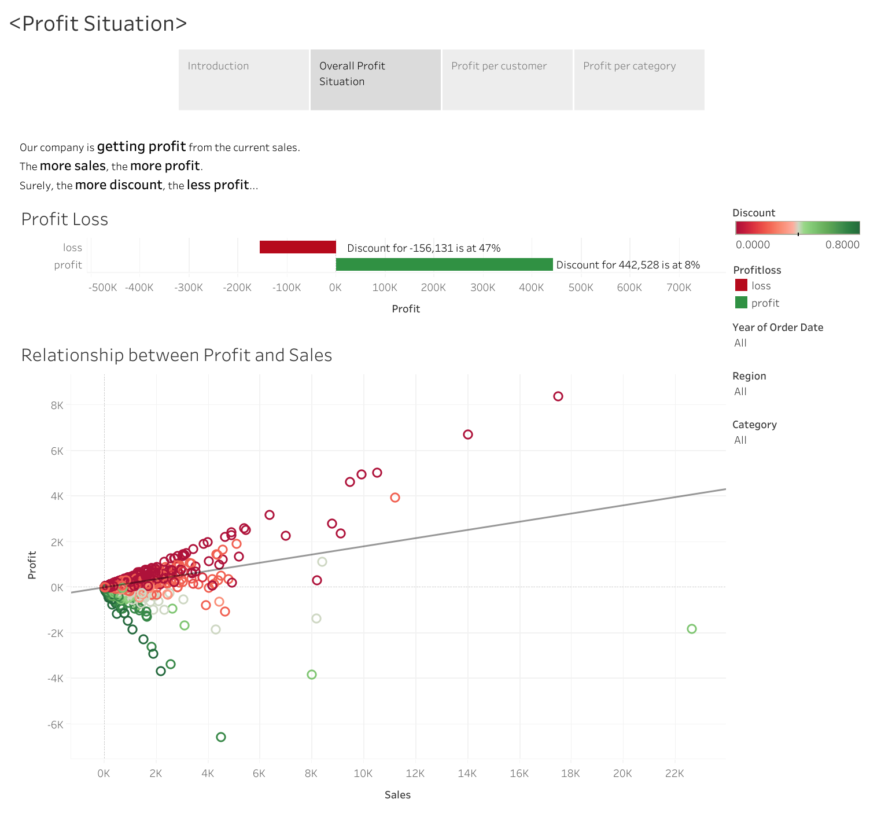

Slide 4
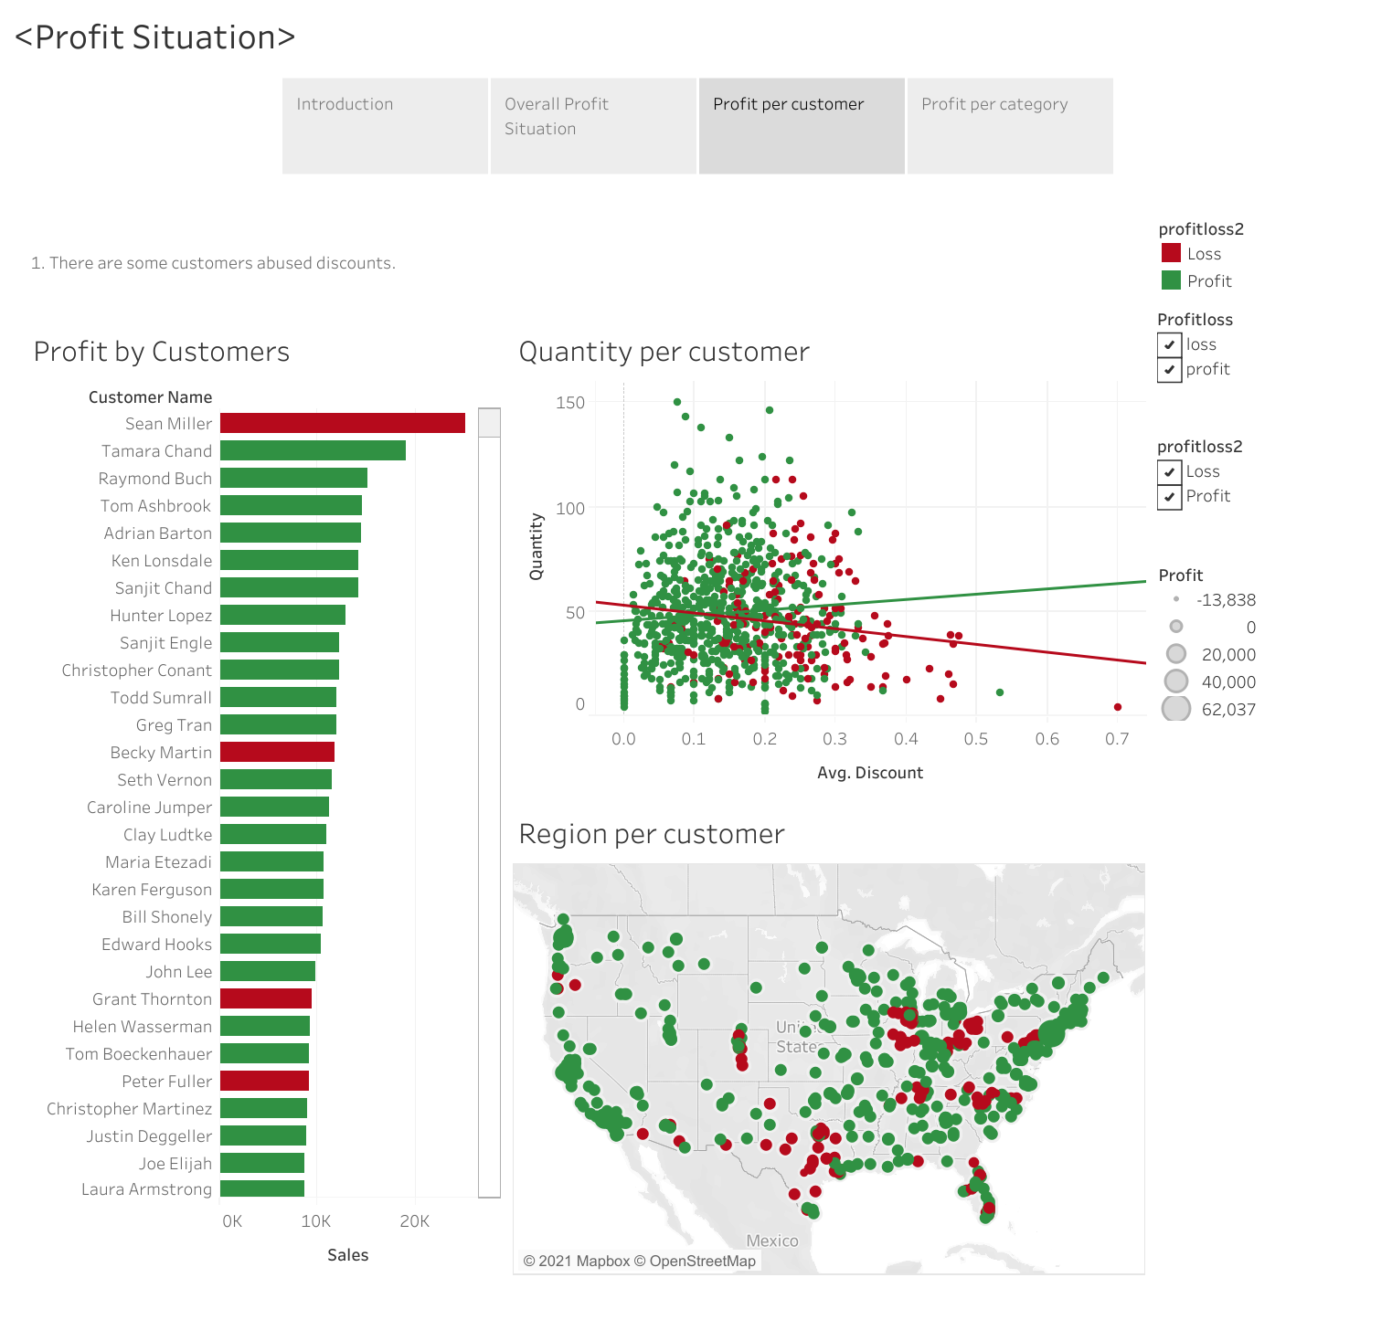

Slide 5
